Slide 1
RDS Webinar RDS+61850
Erik Wiborg, 2024

Slide 2

1. RDS implementation at Statkraft

Slide 3
Purchasing
Maintenance
Risk management
Process Control
Asset management
Asset condition monitoring
Documentation
Information availability
System information management
…

Slide 4

+ Location
%Type
- Product
= Function
Notes:
Så tett opp til logo som standarden har å by på
Tenk prosessdiagram, enlinjeskjema
Tenk Kart, planoversikt
Tenk sammenstillingstegning, IKEA

Slide 5



Process
Local Control
Remote Control
Network Mngr
(End user)
Dispatch
Operation path
Production
Local data collection
RDS + 61850
Data Acquisition
CDP
Data analysis
(End user)
OneView
Analysis path
Maintenance

Slide 6
Implementation principles:
Step-by-step
Only what is relevant
(signals)

Slide 7
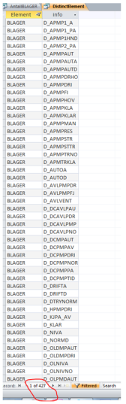
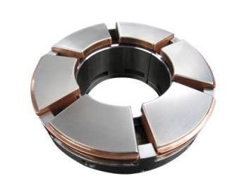

Slide 8
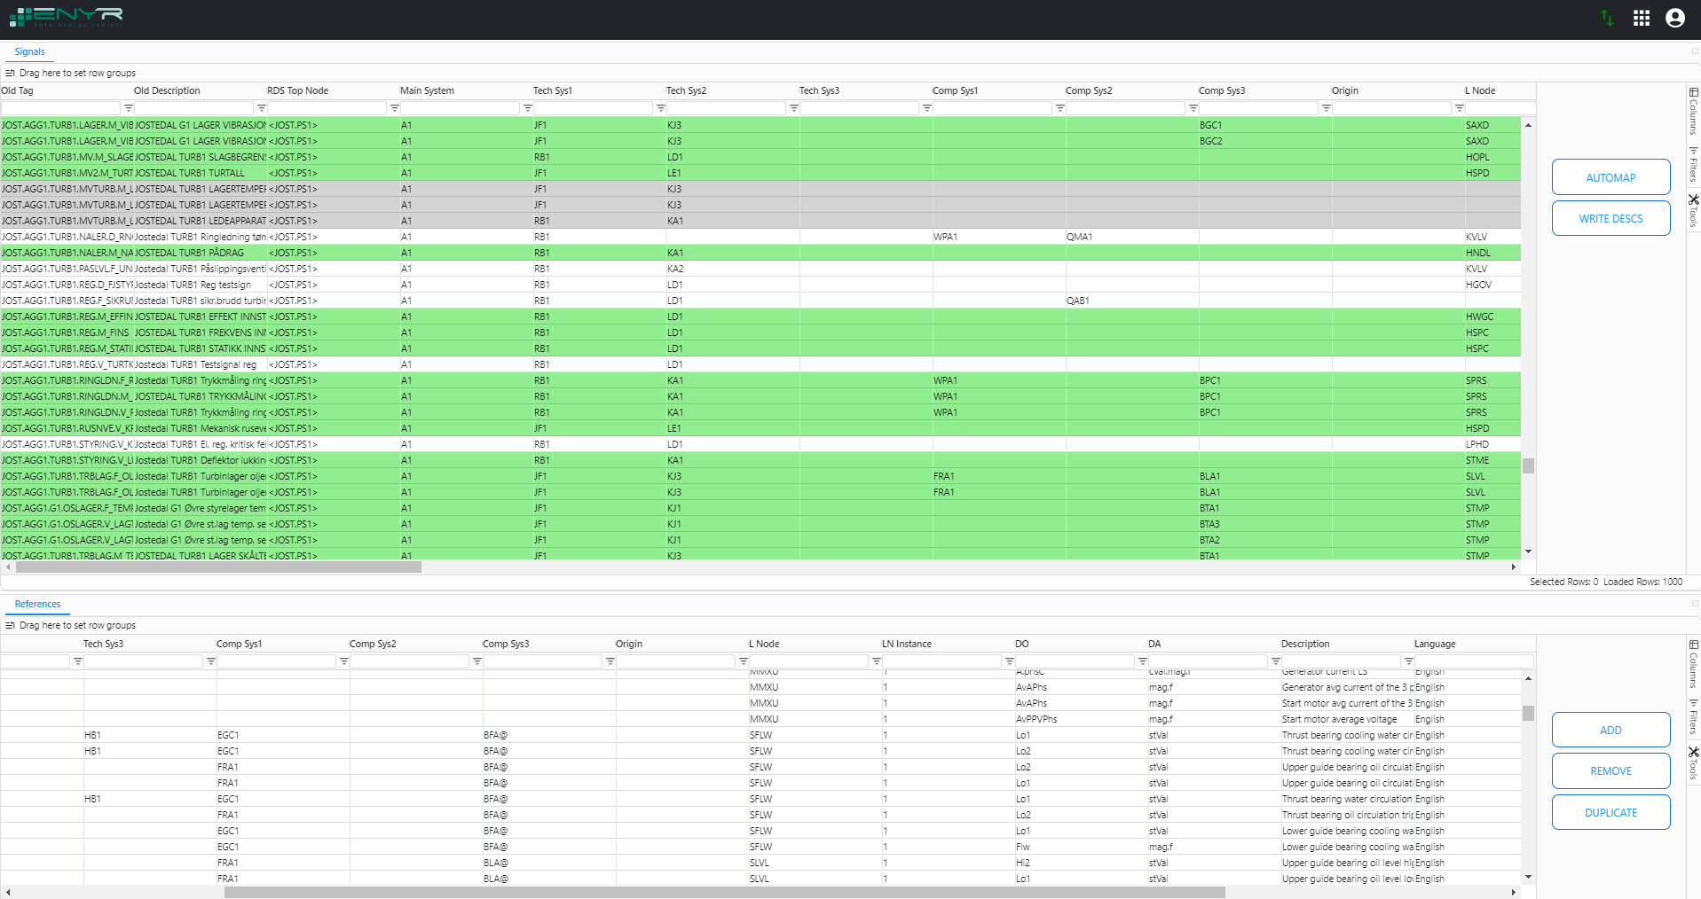


TRANSLATION
JOST.AGG1.TURB1.TRBLAG.F_OLNIVHOY
<JOST.PS1>=A1.JF1.KJ3.FRA1.BLA1/SLVL1.Hi1.stVal
NAMED SIGNALS
Turbine bearing oil level high alarm
Notes:
Deep learning
Generative AI

Slide 9
Interesting for maintenance
Notes:
Deep learning
Generative AI

Slide 10
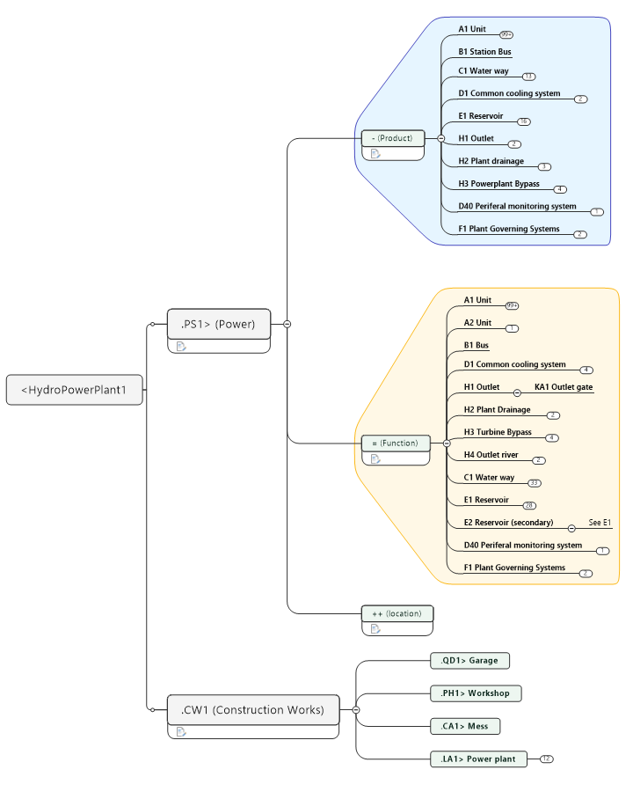

Slide 11
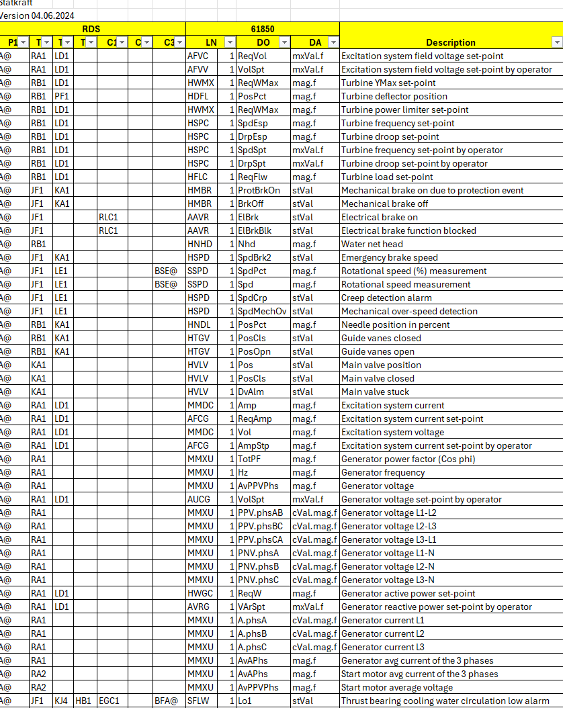
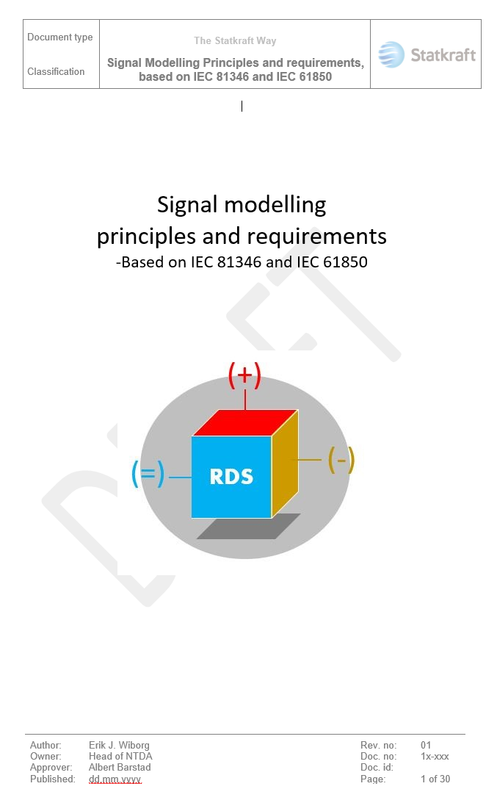
>
>
Named signal list
Guidelines
Example Powerplant
https://github.com/ErikJacquesWiborg/RDS-PS

Slide 12
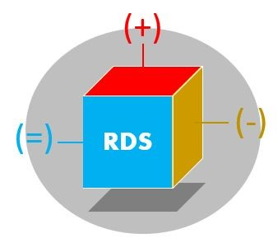
2. RDS implementation principles for Signal modelling

Slide 13

AA - “Support frame system”

Slide 14
=A1 Unit 1
=H3 Unit bypass
=A1.KA1
=A1.RB1
KA1

Slide 15
=A1.KA1.BPA2 Main Valve outlet pressure
=A1.RB1.BPA1 Turbine Inlet pressure
P
=A1.KA1
=A1.RB1

Slide 16
Instantiation (numbering) shall not hold any meaning
mostly

Slide 17
BPA1
Pressure measurement upstream
BPA2
Pressure measurement downstream
P
FILTER
P

Slide 18
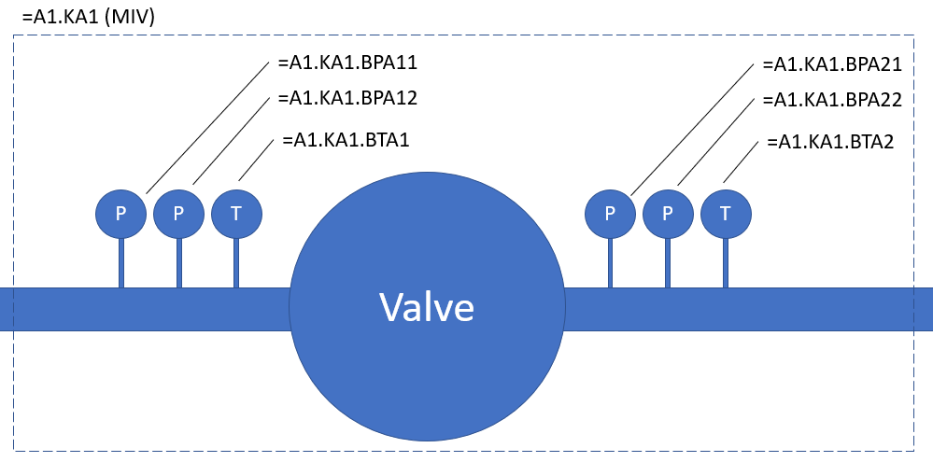

Slide 19
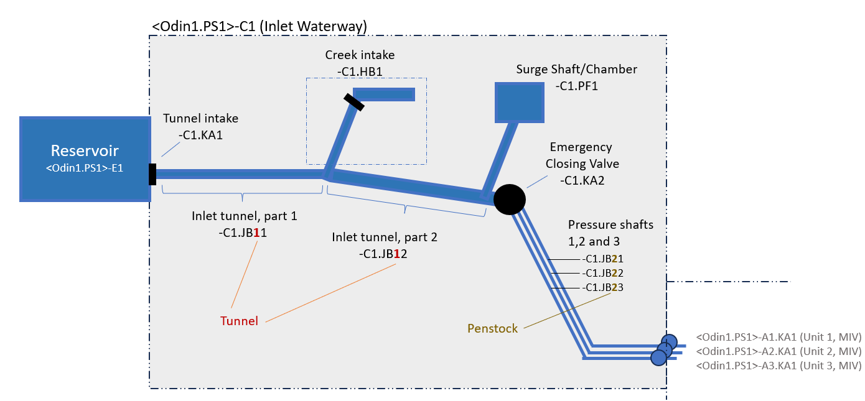

Slide 20
2
1

Slide 21
RDS and signals

Slide 22
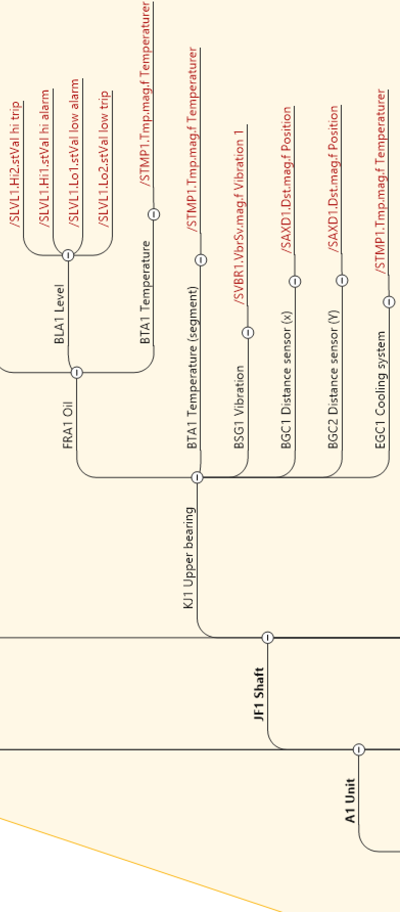
Functional aspect: Leaves are signals/data streams

Slide 23
Signals attach to the source
Accelerometer
Upper Guide Bearing
A1.JF1.KJ1.BSG1/SVBR1.Vbr.mag
Signal description
A1.JF1.KJ1 /SVBR1.Vbr.mag
Notes:
61850 - Layered approach

Slide 24
Functional Hierarchy for smart measurement systems
=D1.CMA1 (Tank)
=D1.CMA1.BLA1 (Smart level measurement)
=D1.CMA1.BLA1.BPA1 (Pressure)
=D1.CMA1.BLA1.BPA2 (Pressure)
=D1.CMA1.BLA1.BPA2 /TPRS1.Prs.mag
=D1.CMA1.BLA1/SLVL1.Lo2.stVal (low level alarm)

Slide 25

3. Introduction to IEC 61850-7

Slide 26
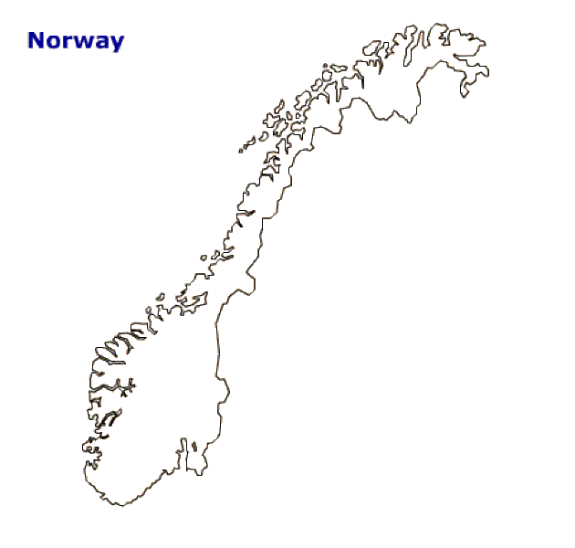
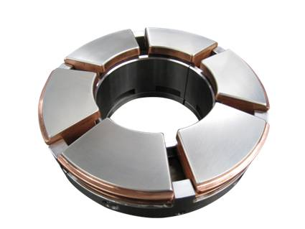
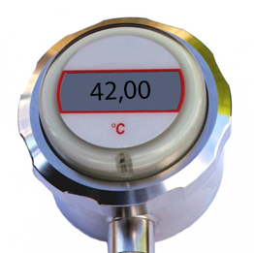
Object reference
Signal Description
IEC 61850
What?
42
Where?
IEC/ISO 81346

Slide 27
Logical Node
Data Object
Data attributes
Functional Constraint
RDS
=A1.KA1.KA / KVLV1 . OpnPos . stVal & [ST]
Notes:
K: Code for Mechanical equipement
StVal : Status Value

Slide 28

Logical Node
=A1.KA1.KA/KVLV1.OpnPos.stVal[ST]
IEC 61850-7-4
IEC 61850-7-410
?
Signal Main Function Group

Slide 29

Equipment control
Temperature monitoring
Alarm handling
HMI

Slide 30
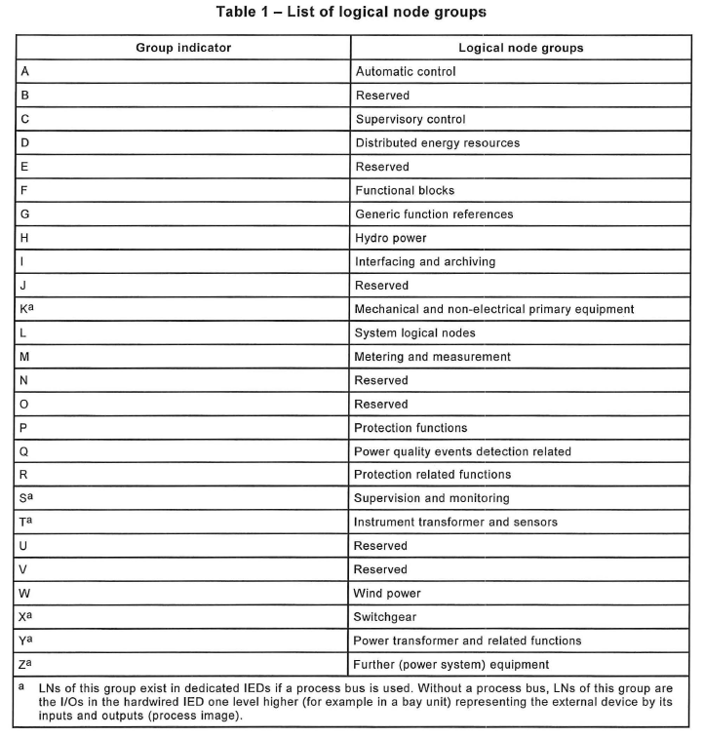
ABCD1
VLV: Valve
BRC: Breaker
TMP: Temperature
Class
Name abbreviation
Instantiation

Slide 31
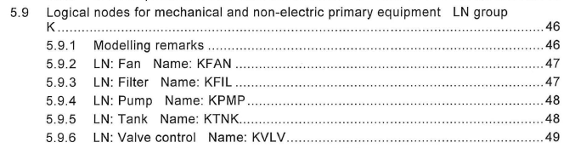

Logical Node – 61850-7-4

Slide 32
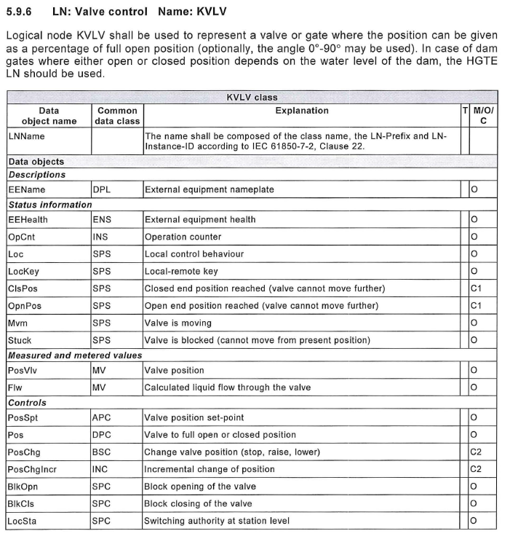
Logical Node

Slide 33
Data objects
=A1.KA1.KA/KVLV1.OpnPos.stVal[ST]
IEC 61850-7-4 (Nodes)
IEC 61850-7-4 (ch.6, Table 10)
?
Nature of the signal

Slide 34
Data Objects

Slide 35
Data Objects
Information – NOT PART OF TAG
=A1.KA1
/KVLV1
.OpenPos
Logical Device
Logical Node
Data Object

Slide 36
Common data class
=A1.KA1.KA/KVLV1.OpnPos.stVal[ST]
SPS
IEC 61850-7-3
?
Data Object Category

Slide 37
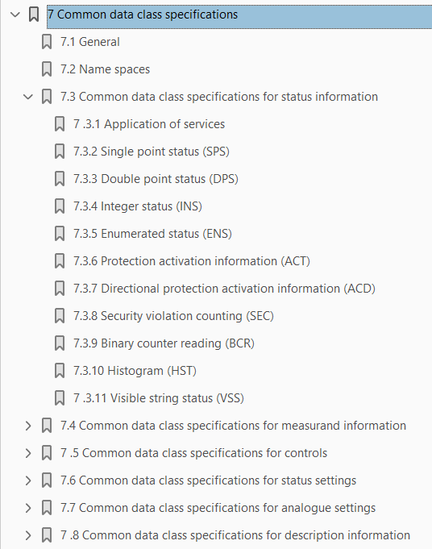
Common data class (61850-7-3)

Slide 38
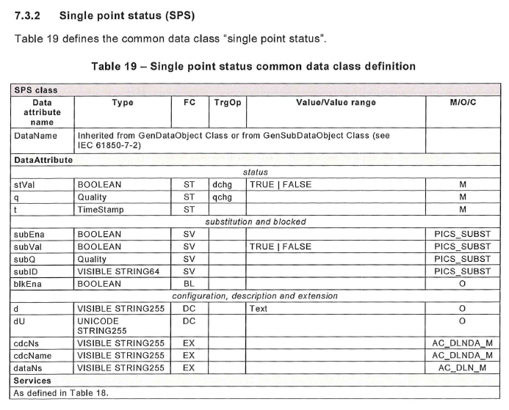
Common data class
=A1.KA1.KA/KVLV1.OpnPos.stVal[ST]

Slide 39
Data Attribute
IEC 61850-7-3 (CDC)
IEC 61850-7-3 (ch.8 - table 64)
?
Signal description

Slide 40
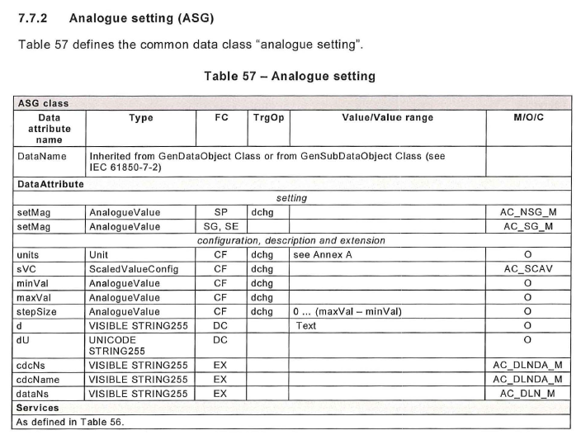

Slide 41
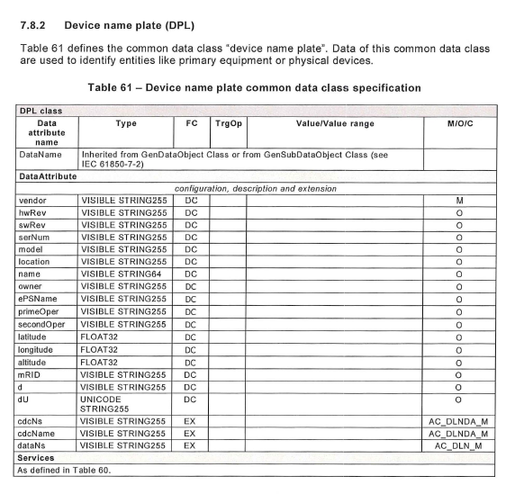

Slide 42
Functional contraint
=A1.KA1.KA/KVLV1.OpnPos.stVal[ST]
IEC 61850-7-3 , Annex B
?
General information type

Slide 43
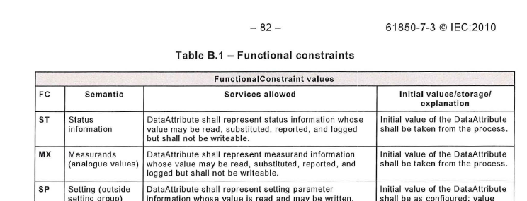
Functional Constraints
see 61850-7-3 , Annex B

Slide 44
…/STMP1.Tmp.mag Temperature Magnitude
…/STMP1.Hi1.stVal Temperature high, alarm
…/STMP1.Hi2.stVal Temperature high, trip

Slide 45
A1.JE1.KF1/SIML1.CmbuGas.mag
Unit transformer measurement of total dissolved combustible gases (TDCG)
A1.JF1.KJ1.EGC1.BTA1/STMP1.Hi1.stVal Upper guide bearing, cooler 1, cooling water temperature, alarm

Slide 46
Layered hierarchy

Slide 47
Flexible Precise Unambiguous Generic
https://github.com/ErikJacquesWiborg/RDS-PS

